Slide 1
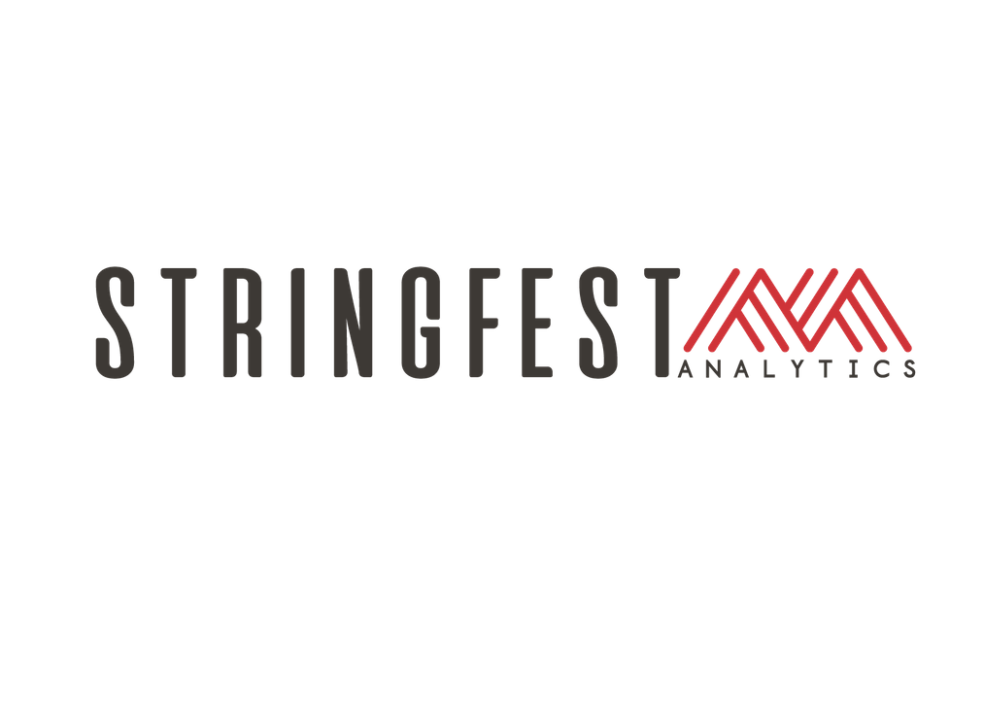
PYTHON FOR EXCEL USERS
Notes:
Welcome!

Slide 2

George Mount
Data Analyst & Educator at Stringfest Analytics
George works as an independent analyst and data analytics educator with the goal to help clients manage their data so they think more creatively. He serves as a technical expert and lead curriculum developer for Thinkful’s data analytics program and is the instructor of the DataCamp course “Survey and Measure Development in R.”
George blogs about data, innovation, and career development at georgejmount.com. He holds a master’s degree in information systems with a certificate of achievement in quantitative methods from Case Western Reserve University
Notes:
Here’s me, you already learned this.

Slide 3

WELCOME
Where are you from?
What interests you about Python?
What have you coded before?
Python for Excel Users
Notes:
You may have already answered this but I would love to know where everyone is coming from and what are your objectives for this course, what interests you about Python? And is this your first time coding? I would say if you are in this class you have kind of done some coding already as Excel users, but just kind of reading the room about what brings everyone here and what they are hoping to get today.

Slide 4
COURSE OBJECTIVES
Load, view and write spreadsheet files from Python
Perform common data wrangling tasks such as sorting, filtering, and aggregation
Navigate and execute code in Jupyter notebooks
Identify, install and implement useful packages for your needs
Not panicking
Python for Excel Users
Notes:
All right, we have a ton of stuff to do today so I apologize now if we don’t get through it all.
We’ll be spending most of our time coding in Python, big surprise and I will make sure to spend some time working with spreadsheet data in Python, to bridge that gap.
But also I want to bridge that knowledge gap, and tap your memories for things that you probably do with data all the time, like sort, filter, and merge. You do this all the time in Excel and you know why they are so important! They are also important in Python, so I want to help you take that mental model of working with data and apply it to Python.
Now as you’ll see working with Python is similar to Excel in some ways but also different, one big difference is our interface for working with Python. We will use Jupyter notebooks which are quite popular, and that will make sense why as we begin to use them, they make code much more beautiful than I thought it would ever be.
And to build on the planetary analogy from Jupyter, Python is a huge universe of packages, we will get into packages later in the course, but you can think of them as like the app store. We will look at what makes these packages so cool – in many ways, it’s cooler than the app store.
Finally this is not easy stuff! So I want to make sure you feel comfortable with your first steps in Python! By relating what we are learning to what you already know that will be a huge help in getting you familiar with this content, I want you not to panic.

Slide 5
FOLLOWING ALONG
Each section is a sub-folder
Demos = follow along with me
Drills = try it yourself
Python for Excel Users
Notes:
I want this course to be interactive, learning works best if I show you something and then you do it. If you sit here and listen to me talk for three hours, I don’t know how much you are going to get out of it.
So I will try to stay on pace here so that each section corresponds to about an hour. Most of the time will be spent in Jupyter notebooks and there will be ample time for you to practice, I have what amounts to fill in the blank coding challenges, I also have solution files for you to compare your work and we will go through the solutions together.

Slide 6



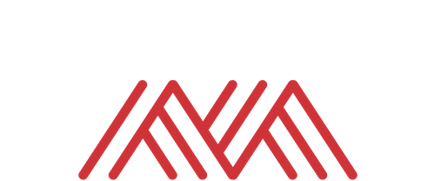
WHY LEARN THIS WAY?
“Students learn new ideas by relating them to what they already know, and then transferring them into their long-term memory.”
-- Paul Bruno, “How People Learn: An Evidence-Based Approach”
Notes:
Now why am I so bent on this idea of “Python for Excel Users?” Why not just do a Python introduction? Well the way I see it, you already know A LOT about coding, so why waste that knowledge! We want to transfer and pivot this knowledge, this is generally how we learn things anyway! So let’s take what you know about Excel and plug it into Python, that gives you a huge leg-up.

Slide 7
1. UP AND RUNNING FROM SPREADSHEETS TO PYTHON
Notes:
OK, a few more slides here and we will jump briefly into Excel and then Python. I know as an attendee I hate listening to this kind of slow wind-up and I just want to start coding ,but it really matters to have all this background knowledge, in fact I would say one of the most important traits you can have as a data person is to be able to contextualize and switch between skills.

Slide 8

PYTHON & EXCEL: “YES, AND” DATA ANALYSIS
Notes:
https://pixabay.com/photos/children-happy-siblings-hide-play-1879907/
OK now one thing I want you to dispose of right now is this idea that we are going to displace Excel and never come back. This is not realistic, it’s not a good idea. Often this Python for Excel users is seen as a changing of the guard, I want to frame it as you are welcoming a new superhero into your crew.
What do I mean by this?

Slide 9
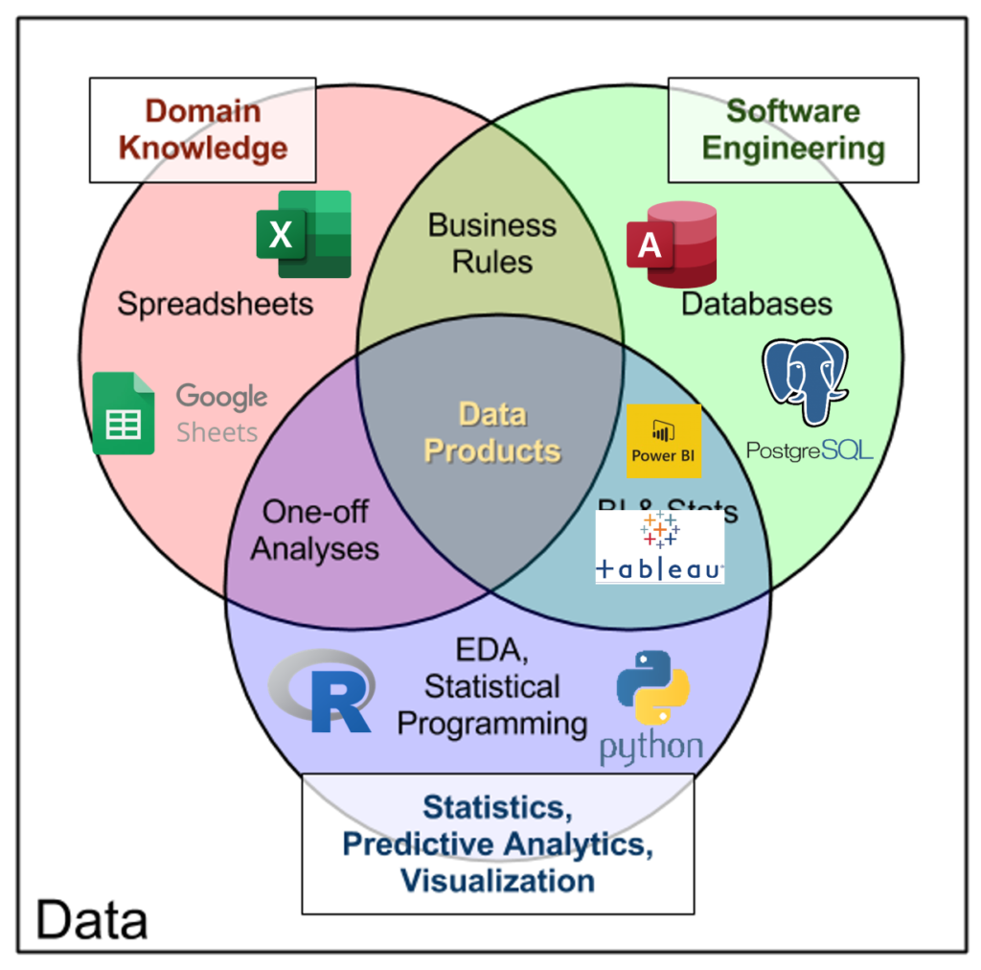
THE DATA ANALYTICS STACK
http://www.datacommunitydc.org/blog/2013/09/the-data-products-venn-diagram
Notes:
I come back to this image a lot, this idea of a “data analytics stack.” These are tools that we often use to build data products, they are all different slices of the same stack, no one is better than the other and they are most effective when we cross different platforms. Excel is a totally valid tool for prototyping and end-user interaction, don’t hate on it! It is a powerful tool. And Python is a powerful tool, it’s best not to put all your eggs into any of these tools, but to know when to use it and when not to, what these tools are and what they are not. Let’s do that with Python.

Slide 10
PYTHON IS: PYTHON IS NOT:
A programming language
Open-source
A spreadsheet
A database
Commercially supported
Notes:
Now, Python is indeed a programming language, I’m assuming you know that already and it hasn’t scared you off yet, congratulations it shouldn’t. One interesting thing with Python is it’s an open-source language, that means that anyone is free to take Python code and do whatever they want with it, and people indeed do all sorts of things with it. They distribute copies of it, they sell code based on it, they mash-up code and pass it around.
Python is not a spreadsheet, by that I mean we can’t go in and execute directly on cells and see the results appear, like we can in regular Excel. It’s also not a database, Python is not really a place to store data, usually you are going to retrieve data from other files such as yes Excel spreadsheets, but also anything from a database to HTML web scraping.
Finally, Python unlike Excel is not commercially supported, that means it’s really powered by amateurs which is really remarkable. Now if you wanted to pay one of those amateurs to help you, you can certainly do that, but this isn’t like Excel where the product is under a closed-shop.

Slide 11
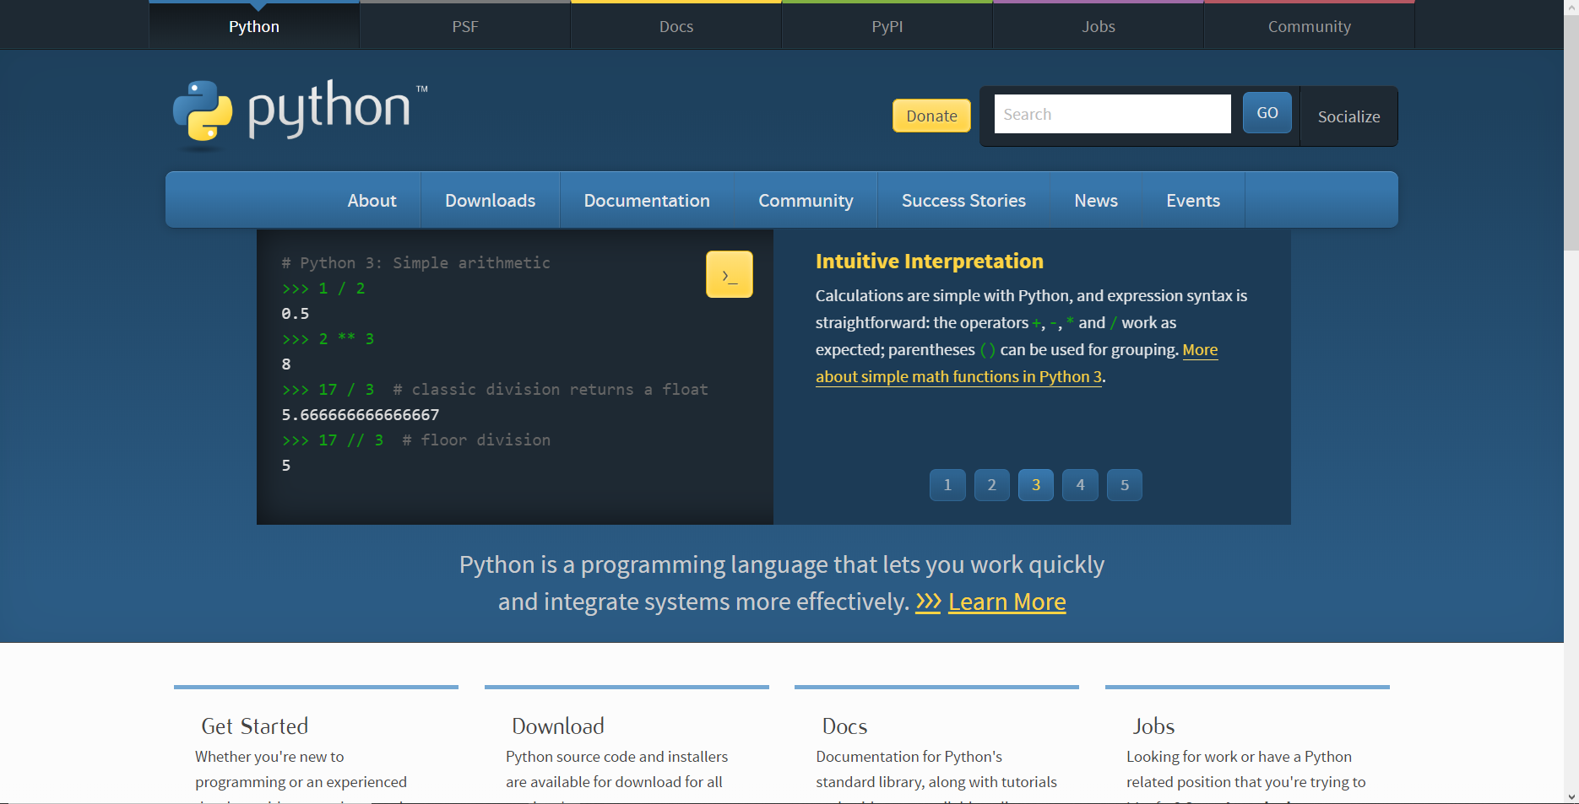
WHERE DOES PYTHON COME FROM?
https://www.python.org
Notes:
Now when you want to get started with Excel it’s pretty simple, you purchase and download a copy of Excel!
With Python it’s a little different. Now you can download the “source code” of Python, from the Python Foundation. This is where the official Python language is maintained. But this is open-source so people are welcome to make copies of it and distribute it on their own.

Slide 12
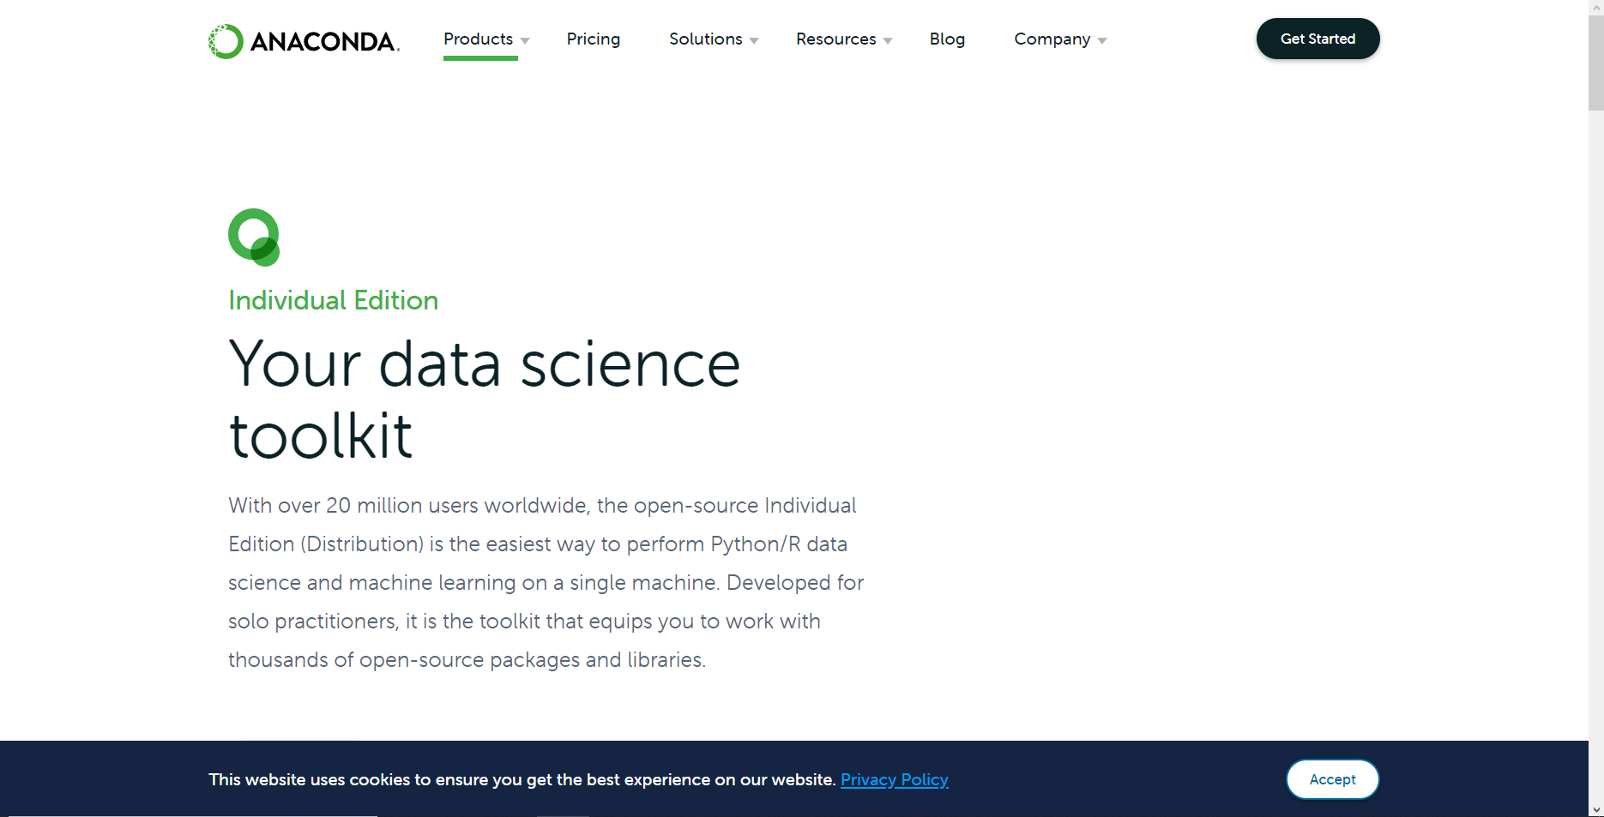
ANACONDA: A PYTHON HAND-ME-DOWN RE-PACKAGING DISTRIBUTION
https://www.anaconda.com/products/individual
Notes:
And this is what the Anaconda distribution does. It’s a _distribution_ or repackaging of the code that includes some extra goodies. Now, we are going to be using a cloud-based instance of Python, so you don’t have to install anything. But if you want to do that after the class, I have this as a recommended follow-up to download Anaconda.

Slide 13
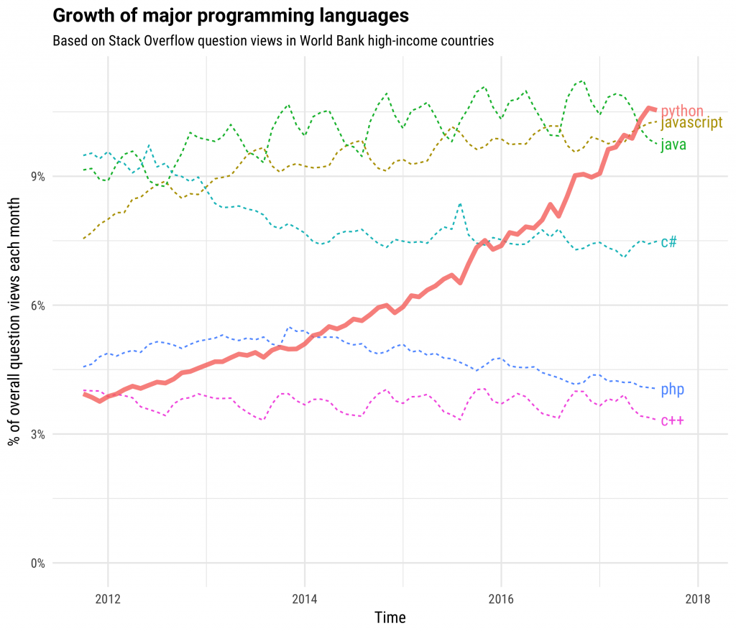
ADVANTAGES OF PYTHON:
It’s free
It’s powerful
It’s popular
https://stackoverflow.blog/2017/09/06/incredible-growth-python/
Notes:
Now why take the time to learn a new programming language? It’s hard work. But there are so many benefits, especially for Python, since it is free, you are really able to learn a lot with the only cost really being your time and effort, not a bad deal considering how much you can do, I mean really anything from web development to machine learning is possible in Python which is pretty cool and explains just why it’s so popular, it’s definitely an in-demand skill that will support you in your career, and just learning how to code is such a powerful learning experience that it is worth doing. I know it has sharpened my aptitude about working with computers.

Slide 14
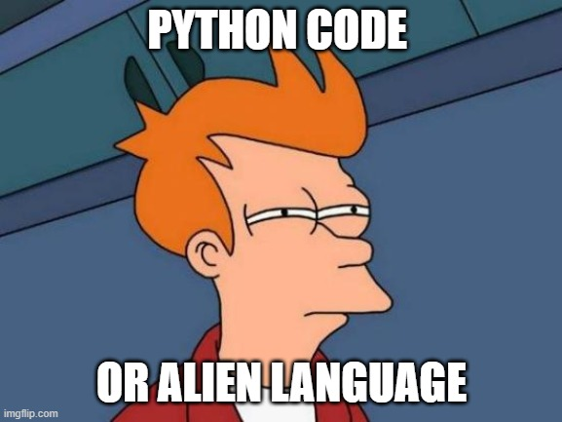
DISADVANTAGES OF PYTHON:
It can be frustrating
Notes:
Probably the biggest disadvantage about learning Python is it can be so very frustrating! You are learning a programming language, it is like learning a new language, so that can be very draining. But I hope with this course I can lay the foundations for you to continue exploring without panicking.

Slide 15
Warm-up
File: calculations-in-excel.xlsx
What are the limitations of our spreadsheet-based analysis?
Follow along with demo notes
Notes:
OK I have a spreadsheet here, let’s briefly open this and ask a few hypothetical questions about our data. Where could Excel use an assist here? I have a demo note file, you are welcome to follow along with that as we go through it.

Slide 16
QUESTIONS?
Notes:
Any questions so far? Let’s spend a couple more slides on getting familiar with Python and we will dive into coding soon I promise.

Slide 17
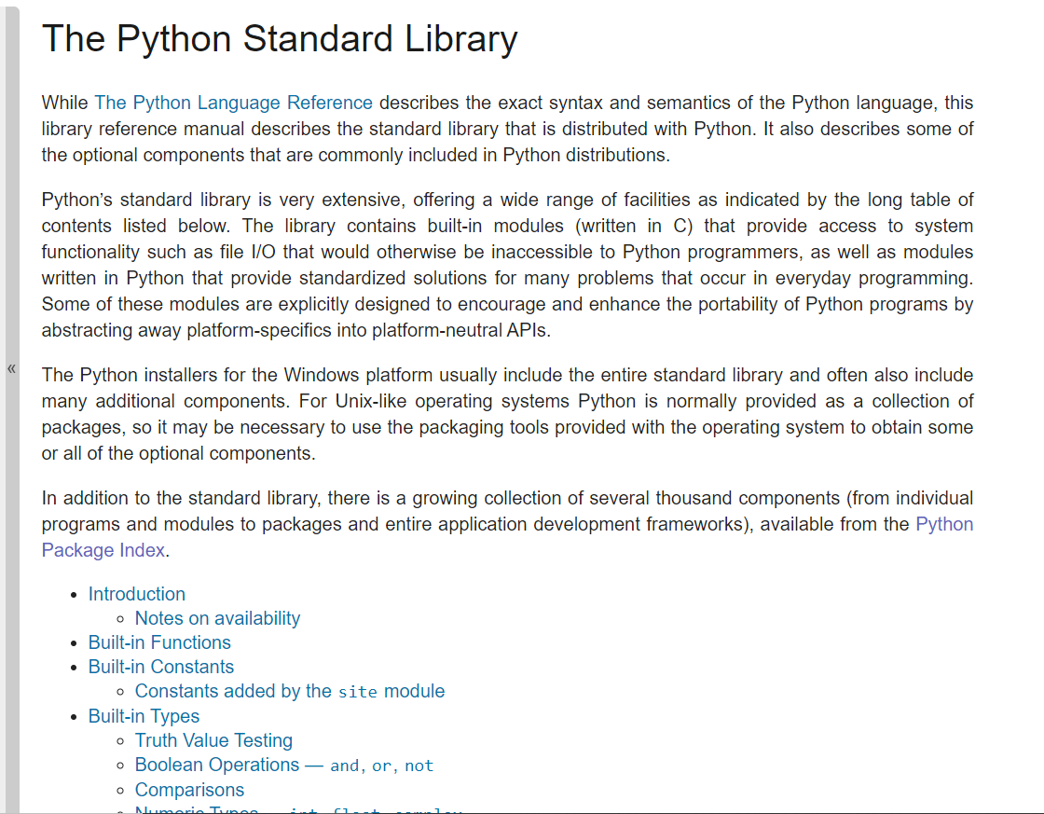
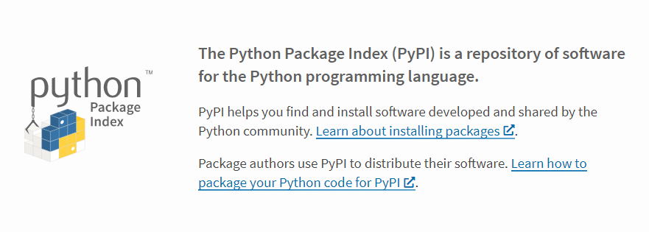
THERE’S AN APP PACKAGE FOR THAT
https://pypi.org
https://docs.python.org/3/library/index.html
Notes:
Any questions on descriptive statistics?

Slide 18
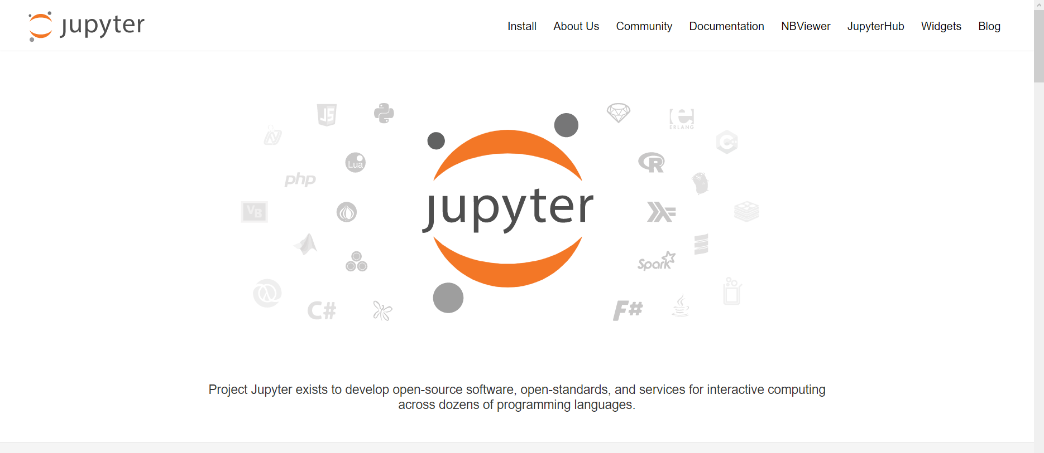
ACCESSING PYTHON FROM JUPYTER
https://jupyter.org/index.html
Notes:
Now remember that Python is open-source which means anyone is welcome to build off of it however they want. This is what Jupyter is, this is a special interface for working with what are known as Python notebooks. There are other ways to execute and work with Python code, for example if you’ve heard of VS Code or PyCharm, those are other code editors that would allow us to run the Python code, but Jupyter notebooks are great teaching tools so we’ll be using those.

Slide 19
QUESTIONS?
Notes:
We really just scratched the surface here with linear regression! But hopefully it gives you a sense of how it works. And really it’s so foundational to data analysis. It really bridges the gap between stats and data science.

Slide 20
DEMO
hello-from-jupyter.ipynb
The rest of course will be in Jupyter, except for the Conclusion
Notes:
OK now finally let’s get into Python, sigh of relief right!

Slide 21
4. CONCLUSION
Notes:
All right, we are at the end of our whirlwind tour! Here is some future learning for you and some things to check out on the O’Reilly learning platform.

Slide 22
Future learning
Programming
Conditional statements
User-defined functions
Loops
Remote data sources
Relational databases
APIs
pandas, matplotlib/seaborn … oh my!
Notes:
Now we got into some common data-wrangling tasks you might do such as sorting and filtering. There is more you can program Python to do to help you process data, this gets into some more intermediate programming techniques such as writing if/else statements, writing your own functions or writing loops. We did not get into these topics but if you check out the books I suggest you will learn more.
Also we really just worked with reading Excel files and csv files into Python however it’s likely you’ll need to get data from other sources, such as relational databases for application programming interfaces or APIs, for APIs especially knowing some things about user-defined functions and loops will help a lot toward collecting that data.
Finally, pandas, matplotlib and seaborn are the bread and butter of working with data in Python so continue learning about them! You will use them for nearly everything you do with data in Python.

Slide 23
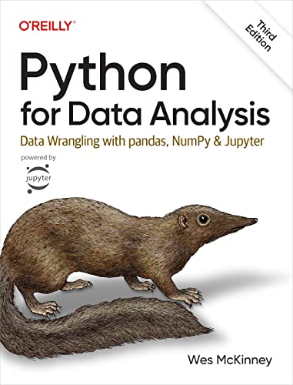
Python for Data Analysis,
3rd Edition by Wes McKinney
On O’Reilly Learning at https://learning.oreilly.com/library/view/python-for-data/9781098104023/
Human Centered Design • MDLS 2020
Notes:
This book is the bible for manipulating data with Pandas, so take a look, it will be a good combination of reinforcing what you’ve learned today and then learning some new things. But I hope you enjoyed working with Pandas because it’s all over your future in Python 😊.

Slide 24

Advancing into Analytics, by George Mount
https://learning.oreilly.com/library/view/advancing-into-analytics/9781492094333/
Human Centered Design • MDLS 2020
Notes:
This is my new O’Reilly book. It will be good practice for some of the Python techniques you’ve learned and it will also go deeper into the statistical analysis. You will learn a bit about R as well. By the end of the book you’ll be able to explore

Slide 25
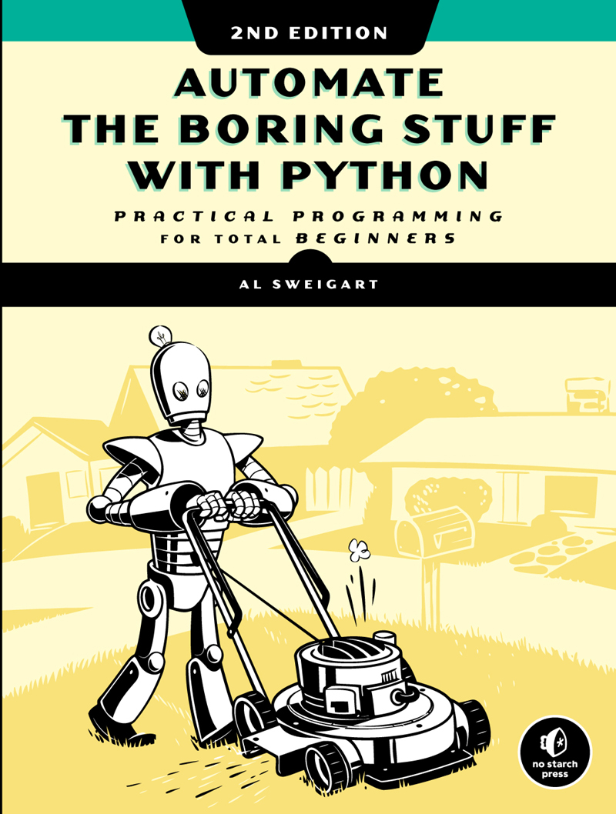
Automate the Boring Stuff with Python, 2nd Editition
by Al Sweigart
On O’Reilly Learning at https://learning.oreilly.com/library/view/automate-the-boring/9781098122584/
Human Centered Design • MDLS 2020
Notes:
I really like this book because it can show you how to automate all sorts of things in Python, including spreadsheets. It will show you how to manipulate Google Sheets, send emails, Word Docs, etc, so maybe you would want to not just write the workbook from Python but then send it out over email, read this book and learn how. You will learn some more advanced programming techniques such as writing your own functions or loops.

Slide 26
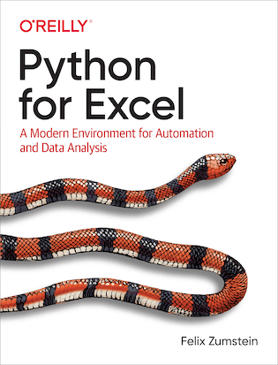
Python for Excel by Felix Zumstein
On O’Reilly Learning at https://learning.oreilly.com/library/view/python-for-excel/9781492080992/
Human Centered Design • MDLS 2020
Notes:
This book is not finished yet but you can see it take form on the O’Reilly site, pretty cool! I showed you some of the possibilities of using Python to drive Excel at the end of the course, this book is going to really focus on that intersection. You will learn a bit more about pandas as well.

Slide 27
LET'S TALK
LINKEDIN
linkedin.com/in/gjmount
EMAIL ADDRESS
george@stringfestanalytics.com
WEBSITE
stringfestanalytics.com
GITHUB
github.com/summerofgeorge
Notes:
Thanks for coming! Feel free to contact me anytime, find me on LinkedIn, I also write frequently on this stuff so check out my website too.

Slide 28
QUESTIONS?
Notes:
Any final questions?

Slide 29

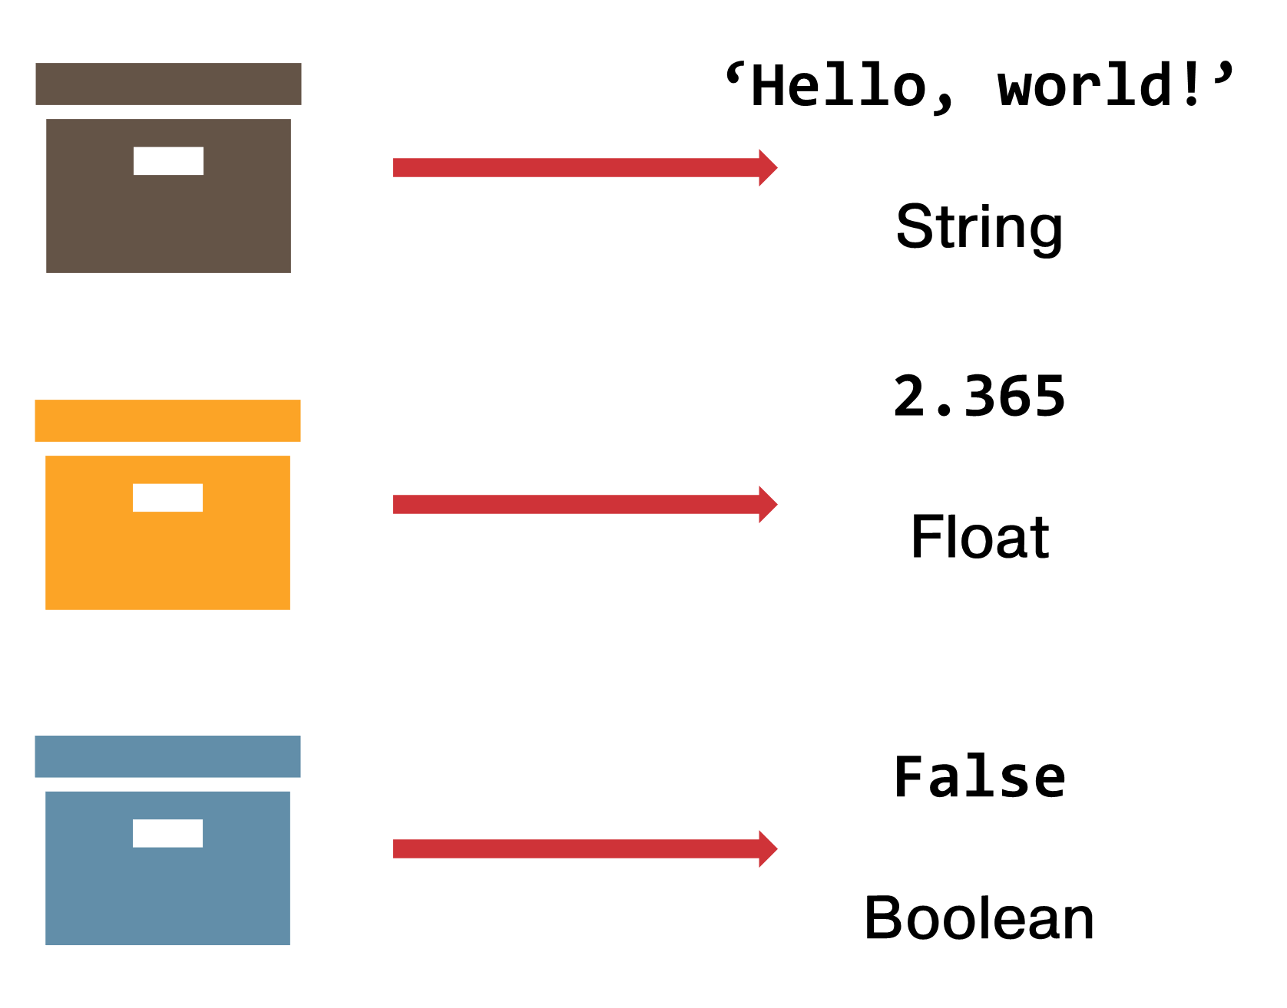


‘Hello, world!’
String
2.365
Float
False
Boolean
Notes:
Any questions on descriptive statistics?

Slide 30

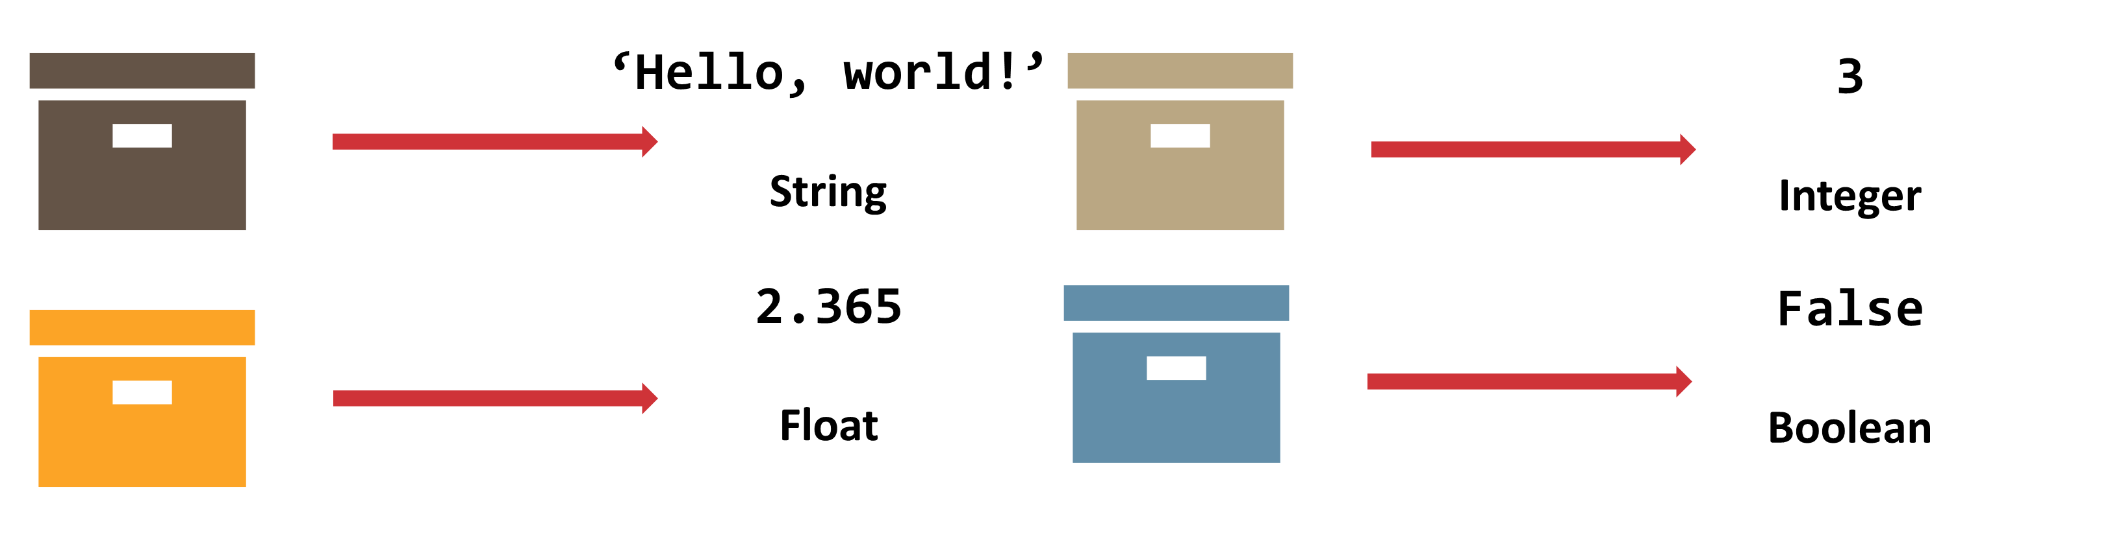
‘Hello, world!’
String
3
Integer
2.365
Float
False
Boolean
Notes:
Any questions on descriptive statistics?

Slide 31
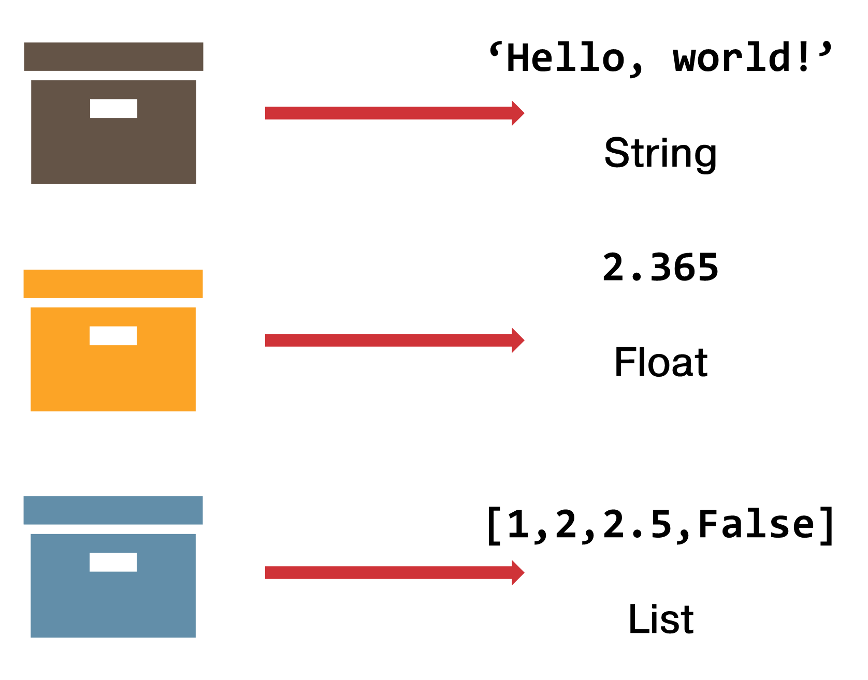
‘Hello, world!’
String
2.365
Float
[1,2,2.5,False]
List
Notes:
Any questions on descriptive statistics?

